Slide 1

Armed Forces College of Medicine
AFCM

Slide 2

Chronic Coronary Syndrome
Prepared By
Dr. Ahmed M. Abdel-Salam
MD cardiology, Ain Shams University

Slide 3
ILOS
At the end of this session you should
be able to:
Chronic coronary syndrome “CCS” & its etiology.
The pathophysiology of CCS.
Clinical manifestations of CCS.
Differential diagnosis of CCS.
Non Invasive investigations for CCS.
Different modalities of CCS treatment.
Microvascular angina.
Vasospastic angina.
Refractory angina.

Slide 4
CCS: - Etiology
Most commonly due to obstruction of the coronary arteries by atheromatous plaque.
Obstructive CAD may be by non-atherosclerotic causes:
Congenital abnormality.
Myocardial bridging.
Associated with systemic vasculitis.
Radiation – induced coronary disease.
Coronary ectasia (non-obstructive CAD)

Slide 5
CCS: - Pathophysiology
Atherosclerotic Plaque Burden
Stable Plaque
Unstable Plaque
Small Lipid core.
Thick fibrous cap.
Large Lipid core.
Thin fibrous cap.
No Complications
Complications

Slide 6
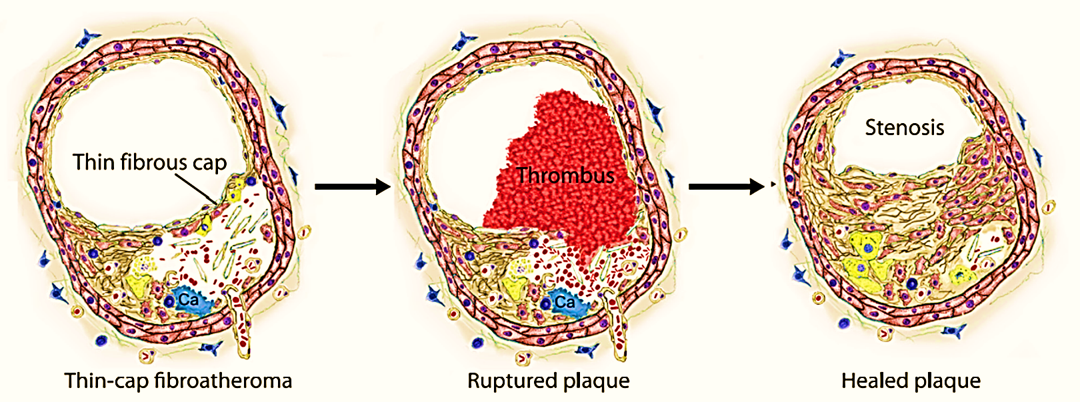
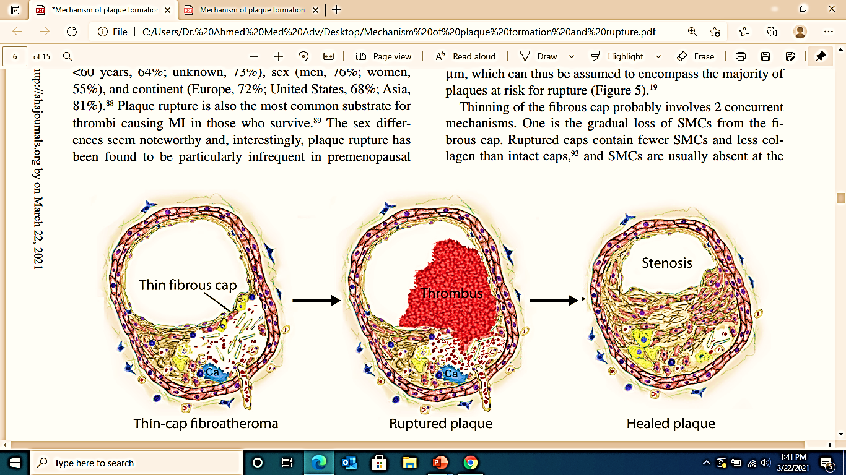
CCS: - Pathophysiology
Plaque rupture & erosion
Majority of ruptures and erosions are asymptomatic
Most ACS are precipitated by plaques that did not cause significant stenosis on angiography
Gradual coronary
narrowing
NOT Candidate for Intervention

Slide 7
CCS: - Clinical Manifestation
Typical Chest pain (TCP):
Short duration.
Stationary.
Infrequent.
Induced by exercise or stress.
Relieved by rest & sublingual nitrate.
Nocturnal Angina:
Angina at night.
Raise the suspicious of sleep apnea.

Slide 8
CCS: - Clinical Manifestation
Angina Equivalent:
Symptoms other than chest pain like dyspnea, fatigue & faintness.
Usually occurs in old age and diabetic patients.
Usually due to peripheral neuropathy.
Exertional dyspnea may be an early indicator of CAD.
Gradual onset with maximum intensity over a period of minutes before dissipating

Slide 9
Diffrential Diagnosis of Chest Pain:
Pleuritic chest pain:
Localized to the tip of one finger, very brief episodes, not related to exertion and may radiate to lower limbs.
Esophageal disorder:
GERD, esophageal motility disorders, biliary colic, musculoskeletal disorders.
Dissecting aortic aneurysm.

Slide 10
Diffrential Diagnosis of Chest Pain:
Pulmonary Embolism.
Severe pulmonary hypertension
Acute Pericarditis

Slide 11
CCS: - Non – invasives test
Laboratory tests:
Aim to detect unproperly controlled risk factors.
Full lipid profile (T.Cholesterol, LDL – C, HDL, VLDL, chylomicron).
Blood glucose level (Fasting, post prandial & Glycated HbA1c).
Liver function test (AST, ALT) to follow statin toxicity.
Renal function test (Renal Impairment is associated with high morbidity & mortality.
Hs CRP (give an idea about the underlying inflammation).
CBC (anemia aggravate CCS manifestation).

Slide 12
CCS: - Non – invasives test
Electrocardiogram (ECG) :
Resting ECG
Non specific ST/T changes with or without Q wave (most common).
LBBB (relatively carry poor prognosis).
VPCs (low sensitivity & specificity for CAD).
LVH (poor prognostic factor).
N.B
During Angina episodes > 50% abnormal ECG can be detected in CAD patients with normal resting ECG
Ambulatory ECG
Low sensitivity in comparison to exercise ECG
LBBB: Left bundle branch block. VPCs: Ventricular premature contractions.
LVH: Left ventricular hypertrophy. CAD: Coronary artery disease.

Slide 13
CCS: - Non – invasives test
Stress ECG:
The predictive value for CAD is high (90%) if typical chest pain and ECG changes (ST segment depression > 1mm).
Early onset or long persistence of ST segment depression after exercise test termination may indicate multivessel CAD.
Non interpretation: LBBB, pacemaker.
Anti-ischemic therapy lower the sensitivity of the stress ECG test. So, we need to stop this medication before the test:
Beta blockers/CCBs: 2 – 3 days.
Nitrates, short acting CCBs: 1 day.
CCBs: Calcium Channel Blockers

Slide 14
CCS: - Non – invasives test
Nuclear cardiology techniques (stress MPI):
Used radioactive substances are either Thalium-201 or Technetium-99m.
More expensive than stress ECG.
More sensitive than stress ECG in detecting single coronary artery disease.
More accurate in patient with resting ECG abnormality.
N.B
Regular stress ECG should always be considered first in patients with chest pain and normal resting ECG for screening CAD.

Slide 15
CCS: - Non – invasives test
Exercise stress Echocardiography:
Inexpensive and safe.
Sensitive & specific test.
Detection of abnormality in the movement of the different segments of myocardial walls which is termed wall motion abnormality (WMA).
Simultenous display of rest & post exercise images.
Prefered than MPI in female patients for screening CAD.
N.B
Regular stress ECG should always be considered first in patients with chest pain and normal resting ECG for screening CAD

Slide 16
CCS: - Non – invasives test
Computed Tomography (MSCT) (CTA):
Expensive but safe.
Same role of coronary angiography but with lower sensitivity.
Calcium deposit which is termed calcium scoring is diagnostic for coronary atherosclerosis.
The absence of calcium on CT imaging is predictive of the absence of significant atherosclerotic coronary artery disease.
Need special precaution as good renal function & slow heart rate.
MSCT: Multislice computed tomography.
CTA: Computed tomography angiography

Slide 17
CCS: - Management
Treatment Modalities
Non Pharmacological treatment
Pharmacological treatment
Revascularization
Relief anginal symptoms.
CV event prevention.
PCI.
CABG.

Slide 18
CCS: - Non Pharmacological treatment
Life style modification.
Control of treatable risk factors (Hypertension, Diabetes Mellitus, Dyslipidemia).
Regular exercise training.
Weight reduction.

Slide 19
CCS: - Pharmacological treatment
Aim of pharmacological treatment:
Reduction of angina symptoms and exercise-induced ischemia.
Prevention of cardiovascular events
Immediate relief of anginal symptoms.
Prevention of symptoms under circumstances likely to elicit angina.
Optimal treatment
Targets unstable angina, MI and death associated with CAD.
Reducing the incidence of acute thrombotic events and the development of ventricular dysfunction.

Slide 20
CCS: - Pharmacological treatment
Anti ischemic medication:
Nitrates:
Short acting nitrates.
Used for Effort angina
Used for angina prophylaxis
Long acting nitrates.

Slide 21
CCS: - Pharmacological treatment
Short Acting Nitrates:
Spray nitroglycerin acts more rapidly than sublingual nitroglycerin.
At the onset of angina symptoms, the patient should rest in a sitting position (standing promotes syncope, and lying down enhances venous return and preload) and take nitroglycerin (0.3 - 0.6 mg tablet sublingually and not swallowed, or 0.4 mg spray to the tongue and not swallowed or inhaled) every 5 min until the pain disappears, or a maximum of 1.2 mg has been taken within 15 min.
If angina persists, immediate medical attention is needed.
Can be administered for prophylaxis before physical activities known to provoke angina.

Slide 22
CCS: - Pharmacological treatment
Short Acting Nitrates:
Isosorbide dinitrate (5 mg sublingually) has a slightly slower onset of action than nitroglycerin due to hepatic conversion to mononitrate.
The effect of isosorbide dinitrate may last < 1 h if the drug is taken sublingually or persist for several hours if the drug is taken by oral ingestion.

Slide 23
CCS: - Pharmacological treatment
Long Acting Nitrates:
Should be considered as second line therapy for angina relief when initial therapy with a beta-blocker or non-dihydropyridine (non-DHP) CCB is contraindicated, poorly tolerated, or insufficient to control symptoms.
When taken over a prolonged period, long-acting nitrates provoke tolerance with loss of efficacy, which requires prescription of a nitrate-free or nitrate low interval of 10 - 14 h.
Nitroglycerin can be administered orally or transdermal through slow-release patch systems.

Slide 24
CCS: - Pharmacological treatment
Long Acting Nitrates:
Titration of dose is essential to obtain the maximal control of symptoms at a tolerable dose.
Discontinuation should be tapered to avoid a rebound increase in angina.
Most common side effects are hypotension, headache, and flushing.
Contraindications include hypertrophic obstructive cardiomyopathy, severe aortic valvular stenosis, and co-administration of phosphodiesterase inhibitors (e.g. sildenafil, tadalafil, or vardenafil).

Slide 25
CCS: - Pharmacological treatment
Beta blockers :
The dose of beta-blockers should be adjusted to limit the heart rate to 55 - 60 bpm at rest.
Discontinuation of betablockers should be tapered and not abrupt.
Caution when betablockers are combined with verapamil or diltiazem due to the potential for developing worsening of HF, excessive bradycardia, and/or atrioventricular block.
Combination of betablockers with a nitrate attenuates the reflex tachycardia of the latter.

Slide 26
CCS: - Pharmacological treatment
Beta blockers :
The principal side effects are fatigue, depression, bradycardia, heart block, bronchospasm, peripheral vasoconstriction, postural hypotension, impotence, and masking of hypoglycemia symptoms.
In patients with:
Recent MI.
Chronic HF with reduced ejection fraction.
Post CABG.
beta-blockers have been associated with a significant reduction in mortality and/or cardiovascular events.

Slide 27
CCS: - Pharmacological treatment
Calcium Channel blockers (CCBs) :
CCBs improve symptoms and myocardial ischemia, but have not been shown to reduce morbidity or mortality
in patients with CCS.
NON-DIHYDROPYRIDINE AGENTS
(Heart rate Lowering
CCBs)
DIHYDROPYRIDINE AGENT
Vasodilators

Slide 28
CCS: - Pharmacological treatment
NON-DIHYDROPYRIDINE agents:
Approved in all varieties of angina (effort, vasospastic, and unstable).
Good safety but with risks of heart block, bradycardia, and HF.
Compared with betablockers, verapamil is associated with fewer cases of diabetes, fewer anginal attacks, and less psychological depression.
Beta-blockade combined with verapamil is not advised (due to risk of heart block).
Verapamil
With its low-side effect profile, Diltiazem has advantages compared with verapamil in the treatment of effort angina.
Like verapamil, it acts by peripheral vasodilation, relief of exercise-induced coronary constriction, a modest negative inotropic effect, and sinus node inhibition.
Diltiazem

Slide 29
CCS: - Pharmacological treatment
DIHYDROPYRIDINE agents:
Long acting Nifedipine
This agent is a powerful arterial vasodilator with few serious side effects.
It has been well tested in hypertensive anginal patients when added to betablockade.
It is proved to be safe, and reduced the need for coronary angiography and cardiovascular interventions.
Relative contraindications to nifedipine are few (severe aortic stenosis, hypertrophic obstructive cardiomyopathy, or HF).
Careful combination with beta-blockade is usually feasible and desirable.
Vasodilatory side effects include headache and ankle oedema.

Slide 30
CCS: - Pharmacological treatment
Ivabradine:
Control the heart rate by inhibition of the If current in the SA node.
Reported to be non-inferior to atenolol or amlodipine in the treatment of angina and ischemia in patients with CCS.
Adding ivabradine 7.5 mg b.i.d. [twice a day] to atenolol therapy gave better control of heart rate and anginal symptoms.
Used as a second-line drug in patients with CCS.

Slide 31
CCS: - Pharmacological treatment
Nicorandil:
Nicorandil is a nitrate derivative of nicotinamide.
It has antianginal effects similar to those of nitrates or beta-blockers.
Side effects include nausea, vomiting, and potentially severe oral, intestinal, and mucosal ulcerations.
Significantly reduced the composite of coronary heart disease (CHD) death, non-fatal MI, or unplanned hospital admission for suspected anginal symptoms in patients with CCS.
Used as a second line drug in patients with CCS.

Slide 32
CCS: - Pharmacological treatment
Ranolazine:
It is a selective inhibitor of the late inward sodium current.
Side effects include dizziness, nausea, and constipation.
In addition, ranolazine increases QTc, and should therefore be used carefully in patients with QT prolongation or on QT prolonging drugs.
In CCS patients, significantly reduce recurrent ischemia, worsening angina, and intensification of antianginal therapy.
Used as a second line drug in patients with CCS.

Slide 33
CCS: - Pharmacological treatment
Trimetazidine:
It appears to have a hemodynamically neutral side effect profile.
35 mg b.i.d. added to beta-blockade improved effort-induced myocardial ischemia.
It is contraindicated in Parkinson’s disease and motion disorders, such as tremor, muscle rigidity, walking disorders, and restless leg syndrome.
Used as a second line drug in patients with CCS.

Slide 34
CCS: - Pharmacological treatment
Stepwise approach in certain circumstances
Patients with low blood pressure:
1st Line
Limited effect on Blood pressure
2nd Line
3rd Line
Control
heart rate
Residual
Ischemia
A low-dose beta-blocker or low-dose non-DHP-CCB can be tested first under close monitoring of tolerance
Ivabradine
(in patients with sinus rhythm)
Ranolazine
or
trimetazidine

Slide 35
CCS: - Pharmacological treatment
Stepwise approach in certain circumstances
Patients with low heart rate:
1st Line
No Effect on
heart rate
2nd Line
3rd Line
Control symptoms
DHP-CCB
(Nifedipine/Amlodipine)
Long acting nitrates
nicorandil,
ranolazine or
trimetazidine

Slide 36
CCS: - Pharmacological treatment
Stepwise approach in certain circumstances
Patients with heart failure:
1st Line
No Effect on
heart rate
2nd Line
3rd Line
If heart rate controlled
LAN (long acting nitrates)
Beta Blocker
(Carvedilol/Bisoprolol/Nebivolol)
nicorandil,
ranolazine or
trimetazidine
2nd Line
If heart rate high
Ivabradine

Slide 37
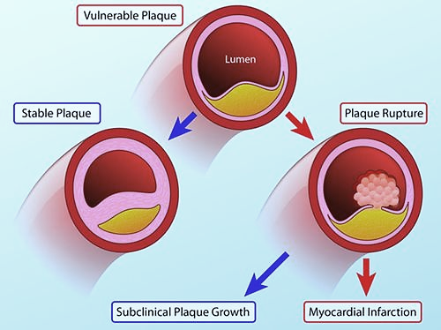
CCS: - Pharmacological treatment
Thin fibrous cap
Event prevention medication:
Large Lipid Core
Anti – thrombotic:
Prevent subclinical plaque growth.
Prevent myocardial infarction.
Aspirin.
P2Y12 inhibitors.
Rivaroxaban 2.5mg
Thick fibrous cap
Plaque Stabilization:
Avoid plaque rupture.
Statins.
RAS blockers.
Beta blockers.
Small Lipid Core

Slide 38
CCS: - Pharmacological treatment
Event prevention medication:
Low dose Aspirin:
Aspirin acts via irreversible inhibition of platelet cyclooxygenase-1 and thus thromboxane production.
The gastrointestinal side effects of aspirin increase at higher doses.
A daily dose of 75 - 100 mg for the prevention of ischemic events in CAD patients with or without a history of MI.
No platelet function testing is required to monitor individual response.

Slide 39
CCS: - Pharmacological treatment
Oral P2Y12 inhibitors:
P2Y12 inhibitors block the platelet P2Y12 receptor, which plays a key role in platelet activation and the amplification of arterial thrombus formation.
Clopidogrel and prasugrel are thienopyridine prodrugs that irreversibly block P2Y12 via active metabolites.
Ticagrelor is a reversibly-binding P2Y12 inhibitor that does not require metabolic activation.
After PCI for stable angina, 6 months of DAPT achieves the optimum balance of efficacy and safety in most patients.

Slide 40
CCS: - Pharmacological treatment
DAPT “Dual Antiplatelet therapy”
PCI “Percutaneous Coronary Intervention”
Stable Patient
ACS Patient
achieves the optimum balance
of efficacy and safety
in most patients
6 months
1 year

Slide 41
CCS: - Pharmacological treatment
Anticoagulant drugs in sinus rhythm:
Anticoagulant drugs inhibit the action and/or formation of thrombin, which plays a pivotal role in both coagulation and platelet activation.
Anticoagulants by rivaroxaban have been shown to reduce the risk of arterial thrombotic events.
This favorable effect was not detected by warfarin or other direct oral anticoagulant.

Slide 42
CCS: - Pharmacological treatment
Anticoagulant drugs in sinus rhythm:
Anticoagulant drugs inhibit the action and/or formation of thrombin, which plays a pivotal role in both coagulation and platelet activation.
Anticoagulants by rivaroxaban (anti Xa at a dose of 2.5mg twice daily) have been shown to reduce the risk of arterial thrombotic events.
This favorable effect was not detected by warfarin or other direct oral anticoagulant.

Slide 43
CCS: - Pharmacological treatment
Statins and other lipid-lowering drugs:
Patients with established CAD are regarded as being at very high risk for cardiovascular events and statin treatment must be considered, irrespective of LDL - C levels.
The goal of treatment is to lower LDL-C by at least 50% from baseline and to < 55 mg/dL although a lower target LDL-C of <40 mg/dL may be considered in patients who have experience a second vascular event within 2 years

Slide 44
CCS: - Pharmacological treatment
RAS “renin angiotensin aldosterone” blockers:
ACE inhibitors or ARBs may be considered for the treatment of patients with CCS with coexisting hypertension, LVEF <_40%, diabetes, or CKD, unless contraindicated (e.g. severe renal impairment, hyperkalemia, etc.).
Neprilysin is an endogenous enzyme that degrades vasoactive peptides as bradykinin and natriuretic peptides. Pharmacological inhibition of neprilysin raises the levels of these peptides, enhancing diuresis, natriuresis, myocardial relaxation, and anti-remodelling, and reducing renin and aldosterone secretion.

Slide 45
CCS: - Pharmacological treatment
RAS “renin angiotensin aldosterone” blockers:
Aldosterone blockade with spironolactone or eplerenone is recommended for use in post-MI patients who are already receiving therapeutic doses of an ACE inhibitor and a beta-blocker, have an LVEF <_35%, and have either diabetes or HF.
Caution when aldosterone blockers are used in patients with impaired renal function [estimated GFR (eGFR) <45 mL/min/1.73 m2] and in those with serum potassium levels >_5.0 mmol/L.

Slide 46
CCS: - Revascularization
Revascularization by PCI or CABG may effectively relieve angina, reduce the use of antianginal drugs, and improve exercise capacity and quality of life compared with a strategy of medical therapy alone.
However, unlike ACS revascularization in CCS is considered if there is significant ischemia by non invasive tests or significant stenosis by coronary angiography or MSCT.

Slide 47
Microvascular angina
Patients with microvascular angina typically have:
Exercise – related angina.
Evidence of ischemia in non – invasive tests.
Either no stenosis or mild to moderate stenosis on coronary angiography.
Secondary microvascular angina - in the absence of epicardial obstruction may result from cardiac or systemic conditions those that cause:
LVH: (HCM, AS, hypertensive heart disease).
Inflammation: (Myocarditis, Vasculitis).
For Medical treatment and control of risk factors.
LVH: Left Ventricular Hypertrophy.
HCM: Hypertrophic Cardio – Myopathy.
AS: Aortic Stenosis.

Slide 48
Vasospastic angina
Patients have pain, that occur mainly at rest, and follow circadian rhythm, with more pain episodes at night and early morning.
Patients are usually younger, and few risk factors than patients with effort angina except for cigarette smoking.
Coronary spasm, should be suspected with patent coronary stents and persistent pain.
For Medical Treatment.

Slide 49
Refractory angina
Refractory angina refers to long – lasting symptoms ( > 3 months) due to established ischemia in the presence of obstructive CAD, which can not be controlled by escalating medical therapy with the use of the 2nd and 3rd lines pharmacological therapy, bypass grafting, or stenting including PCI to CTO.
Incidence is growing with more advanced CAD, multiple co-morbidities, and population aging.
CAD: Coronary artery disease.
PCI: Percutaneous Coronary Intervention.
CTO: Chronic Total Occlusion.

Slide 50
Take Home Message
Chronic Coronary Syndrome (CCS) is part of coronary arterial diseased induced mainly by atherosclerosis.
It is mostly presented by chest pain, however other manifestation may represent angina especially in old age and diabetic termed angina equivalent.
The Differential diagnosis of chest pain may include pleuritic chest pain, esophageal disease, dissecting aortic aneurysm, pulmonary embolism, severe pulmonary hypertension and acute pericarditis.
Investigation for CCS include Laboratory to exclude and follow up risk factors that may precipitate pain. Other investigations include resting & stress ECG, stress ECHO, stress MPI, CTA & CA.

Slide 51
Take Home Message
Treatment of CCS include non pharmacological treatment that aim to life style modification, control of risk factors and weight reduction.
Pharmacological treatment aim to either control of ischemic symptoms by (nitrates, beta blockers, CCBs, Ivabradine, ranolazine, Nicorandil & trimetazidine) or event prevention (mainly statins and anti-thrombotics: Aspirin, P2Y12 blockers and rivaroxaban 2.5 mg).
The third arm in management is revascularization which is indicated in the presence of sizable reversible ischemia +/- significant coronary artery stenosis.

Slide 52
Quiz
Which of the following medications is considered for event prevention:
Ranolazine.
Trimetazidine.
Statins.
Long acting nitrates.
Short acting nitrates.

Slide 53
Quiz
Which of the following medications is considered for event prevention:
Ranolazine.
Trimetazidine.
Statins.
Long acting nitrates.
Short acting nitrates.

Slide 54
Thank You

